Slide 1
Scouting America
Leave No Trace Instructor Course

Slide 2
Leading a Leave No Trace
Level 1 Course, Skills Course, or Workshop

Slide 3
Scouting America Objectives
As a result of this session, each participant will:
Be familiar with requirements and planning considerations to run an effective Leave No Trace Level 1 Course or Skills Course.
Understand the requirements and planning considerations to lead the Scouting America Leave No Trace Basic course and Outdoor Ethics Orientation.
Understand the Training Guidelines for Leave No Trace training.
Know where to find Leave No Trace course guidelines, curriculum, and resources.
Notes:
Note: This is a required session, though these specific objectives are not what is in the ME handbook (pg. 78, 2015) for this session. This session’s material has been augmented to incorporate Scouting America’s Outdoor Ethics training guidelines. The following slide has the Leave No Trace ME Handbook Objectives

Slide 4
Level 1 Objectives
Goals of the Level 1 Instructor Course Guidelines:
To strive for consistent, quality training for all Leave No Trace Course participants.
To provide an easily implemented training structure that encourages training efforts.
To establish a structure that allows Leave No Trace Center for Outdoor Ethics to track and quantify training efforts.
To clarify the role of Leave No Trace in regard to training institutions and individual Instructors.
To identify that there are inherent risks in outdoor activities and to discuss warnings and other information pertaining to Leave No Trace.
Notes:
Note: These Leave No Trace Goals are from the ME Handbook for this session (pg. 78, 2015).

Slide 5
Leave No Trace Courses Facilitated by Level 2 Instructors
Leave No Trace
Scouting America
Leave No Trace Level 1 Instructor Course
Leave No Trace Skills Course
Leave No Trace Workshops
Outdoor Ethics Orientation
Leave No Trace Basics

Slide 6
Other Training Opportunities within Scouting America
Adult
Introduction to Outdoor Leadership Skills (IOLS)
Basic Adult Leader Outdoor Orientation (BALOO)
Wood Badge
Leader Specific Training
Round Table
Youth
Camp Staff
Advancement
Merit Badges
Skills Training
Troop/Patrol Time

Slide 7
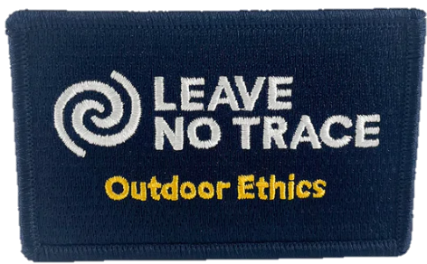
Outdoor Ethics Orientation
60-90 minute Scouting America course outlining the Scouting America Outdoor Ethics program
Must be a Leave No Trace Level 1, 2, 3 Instructor, or TREAD Trainer/Master Trainer to teach
Learning Objectives:
Knowledge of the Outdoor Code and Outdoor Ethics
Knowledge of how Leave No Trace, Tread Lightly!, and The Land Ethic/Stewardship support the Outdoor Code
Knowledge of Outdoor Ethics Awareness and Action Awards Program
Knowledge to locate additional Leave No Trace, Tread Lightly!, and Scouting America Outdoor Ethics resources and opportunities for further training
Reported to Leave No Trace as an Awareness Workshop
Scouting America Training code S110-Youth; S111-Adult

Slide 8
Scouting America Leave No Trace Basics
3-4 hour Scouting America course specific to Leave No Trace
Must be a Leave No Trace Level 1, 2, 3 Instructor to facilitate
Learning Objectives
Knowledge of Leave No Trace and its principles
Understanding the importance of Leave No Trace in outdoor activities
Where to locate additional Leave No Trace resources and opportunities to further Leave No Trace Training
Reported to Leave No Trace as an Awareness Workshop
Scouting America Training Code D74
Notes:
Note: Scouting America Leave No Trace Basics course is being revised in 2025. Check current requirements.

Slide 9
Leave No Trace Workshop
Any Leave No Trace training, one day or less which covers:
Seven Principles of Leave No Trace
Leave No Trace Mission
Hosted by Council, District, Unit, or Individual
Anyone with Knowledge of Leave No Trace can facilitate
Must be Level 1, 2, or 3 to issue Certificate of Completion from Leave No Trace
Emphasize skills and techniques essential to minimum impact ethics and education.
No Scouting America Training code
Reported to Leave No Trace

Slide 10
Leave No Trace Skills Course
16 hours of instruction, 10 in the field, + overnight (strongly encouraged)
Virtual and blended courses offered
Hosted by Organization or Individual
Insurance requirements must be met
Scouting America courses (Council) must complete a Request for Authorization
Instructor Must be:
A Leave No Trace Level 1, 2, 3 Instructor.
Multiple courses require an addition set of Instructors for each course.
Hold current CPR and Standard First Aid certification
Current member of Leave No Trace
Within two years of completing the Level 2 refresher training (online)
The instructor leads and coordinates the instruction with the assistance of another Level 1, 2, 3 Instructor or experienced person knowledgeable in Leave No Trace.

Slide 11
Leave No Trace Level 1 Course
The Level 1 course slides are used only during a Level 2 course.
If you are facilitating a Level 1 or Skills Course, hide the following slides.

Slide 12
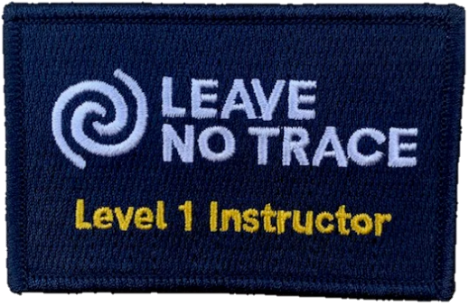
Leave No Trace Level 1 Course
Instructor Requirements
Course Objectives
Administrative Requirements
Couse Organization
Logistics
Course Content Overview
Reporting Requirements
Notes:
DRAFT - https://docs.google.com/document/d/1GbC7SG9GOBU0C55kk4bewirwNxHivN_T8rLv2xClJoM/edit?tab=t.0#heading=h.5p1czrcdsyzi
The bullet points on these slides are the Leave No Trace requirements. The instructor should include how we offer these courses in a Scouting context. Ensure to make the point that Scouting courses must follow Youth Protection.

Slide 13
Level 1 Instructor Course Qualifications
Instructor must be:
Current member of Leave No Trace,
A Leave No Trace Level 2 Instructor,
CPR and Standard First Aid or Wilderness First Aid certified
Within two years of completing the Level 2 refresher training (online).
The instructor leads and coordinates instruction with assistance of another Level 2 Instructor or experienced Level 1 Instructor.

Slide 14
Level 1 Course Objectives
A Leave No Trace Level 1 Instructor candidate will be able to accomplish the following objectives in three basic areas:
Role of the Level 1 Instructor
Describe the role of an Instructor
Discuss the history, goals, and objectives of the Leave No Trace program
Recognize recreation impacts and the means to minimize these impacts

Slide 15
Leave No Trace Level 1 Course
Principles and Practices of Leave No Trace
Discuss the Leave No Trace seven principles in relation to their local environment
Discuss the Leave No Trace seven principles in relation to other environments
Practice the Leave No Trace seven principles
Discuss the ethics of Leave No Trace
Principles and Practices of Teaching
Discuss the three basic learning styles
Define and prepare a class for a target audience
Discuss the management of a class
Prepare a lesson plan for, and present a 15-20 minute lesson

Slide 16
Level 1 Admin Requirements
16 hours of instruction, 10 in the field, + overnight (strongly encouraged, not required)
Virtual and blended course structures available
Hosted by Organization or Individual
Insurance requirements must be met
Participants must be 18 years old
Scouting America requires Course Authorization Form from Sponsoring Council
Multiple courses require an addition set of Instructors for each course.
Notes:
DRAFT - https://docs.google.com/document/d/1GbC7SG9GOBU0C55kk4bewirwNxHivN_T8rLv2xClJoM/edit?tab=t.0#heading=h.5p1czrcdsyzi
The bullet points on these slides are the Leave No Trace requirements. The instructor should include how we offer these courses in a Scouting context. Ensure to make the point that Scouting courses must follow Youth Protection.

Slide 17
Level 1 Admin Requirements
Typically coordinated through the COEA
Participants must sign course release waiver
Reported to Leave No Trace, with roster and waivers
Scouting America Level 1 Code D78
Insurance Requirements
NCAP Requirements

Slide 18
Level 1 Course Organization
Has specific curriculum detailed in the Scouting America Leave No Trace Level 1 Course Manual
Minimum of four participants, maximum 12, age 18+
Multi-course format available provided Instructor/Participant ratio followed

Slide 19
Level 1 Course Logistics
Camping
Cooking
Travel to and from site
Emergency Plans
Weather and where to do presentation
Equipment needed

Slide 20
Level 1 Course Content
Orientation
Need for Leave No Trace
History of Leave No Trace
Education Model and Role and Function of Educators
Personal Leave No Trace Presentations
Cooking
Introduction to the Leave No Trace Seven Principles
Plan Ahead and Prepare
Travel and Camp on Durable Surfaces
Dispose of Waste Properly
Leave What You Find
Minimize Campfire Impacts
Respect Wildlife
Be Considerate of Others
Outdoor Ethics
Lessons Learned on Overnight Camp
Leave No Trace Resources
Visitor Impacts to Wildlife (optional)
Teaching Styles and Learning Styles
Age and Program Appropriate Outdoor Activities
Leave No Trace in Scouting Advancement and Awards
Bringing Leave No Trace to Scouting

Slide 21
Level 1 Course Reporting
How and who to report course to:
-Council Training Report
-Leave No Trace
-Council COEA for yearly reporting

Slide 22
Prepared by
Joshua Lamothe
Revised: April 2025
Sources:
Lnt.org
Scouting America Supplement to the Master Educator handbook

